Slide 1
Wireless Communications
Principles and Practice
2nd Edition
T.S. Rappaport
Chapter 5: Mobile Radio Propagation: Small-Scale Fading and Multipath as it applies to Modulation Techniques

Slide 2
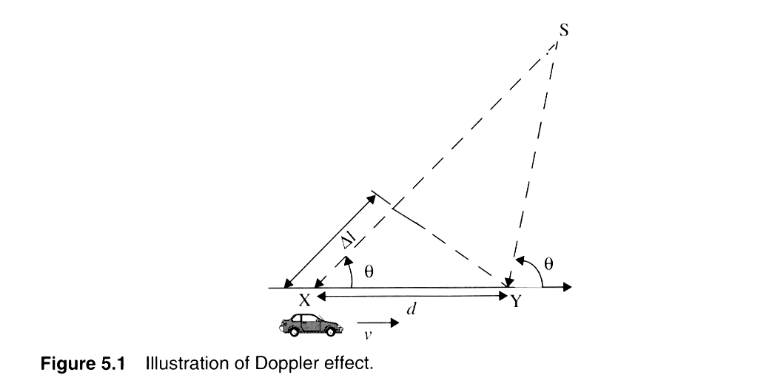
Doppler Shift Geomerty

Slide 3
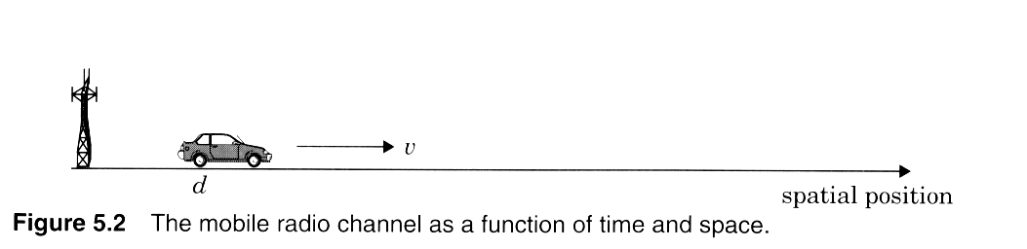
Channel issues
Notes:
Fig. 3.2

Slide 4
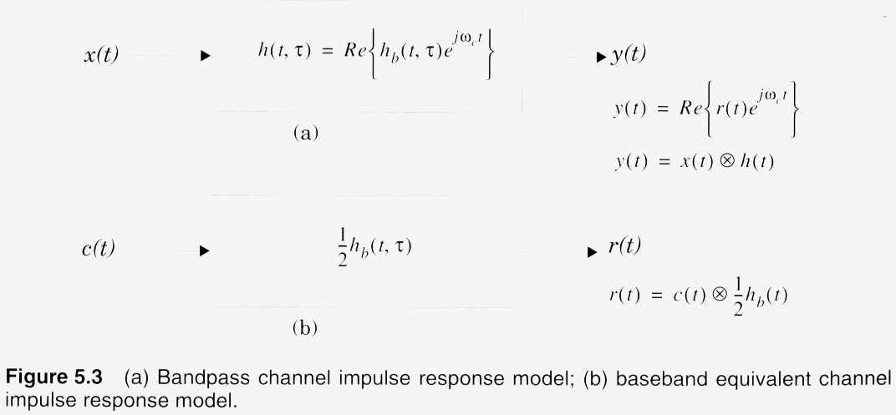
Complex Baseband model for RF systems

Slide 5
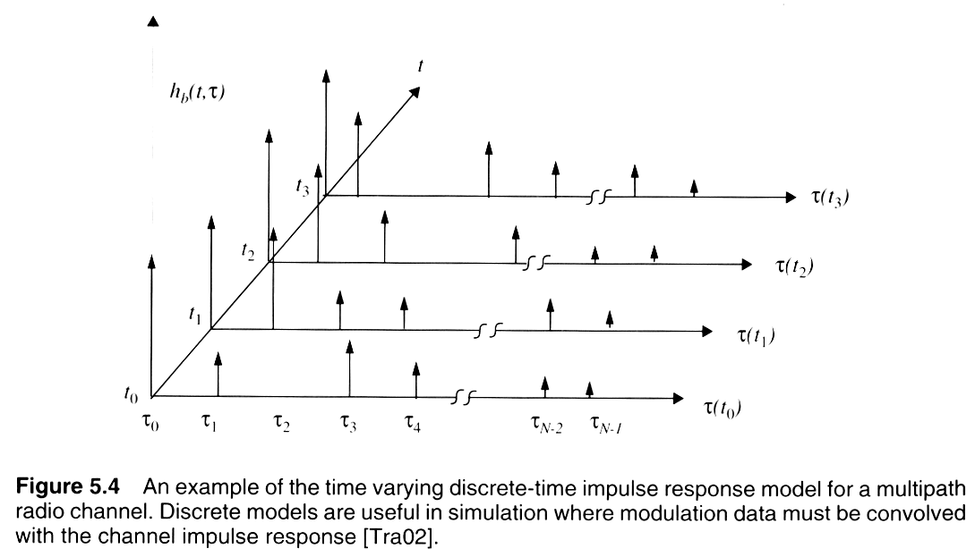
Time-varying impulse response
Notes:
Fig. 2.3

Slide 6
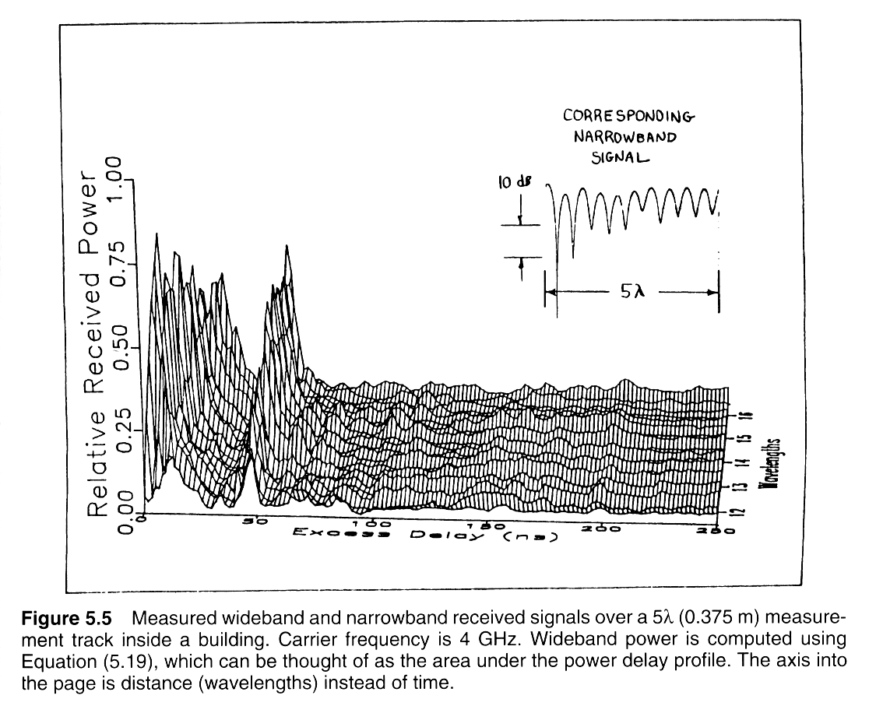
Measured impulse responses

Slide 7
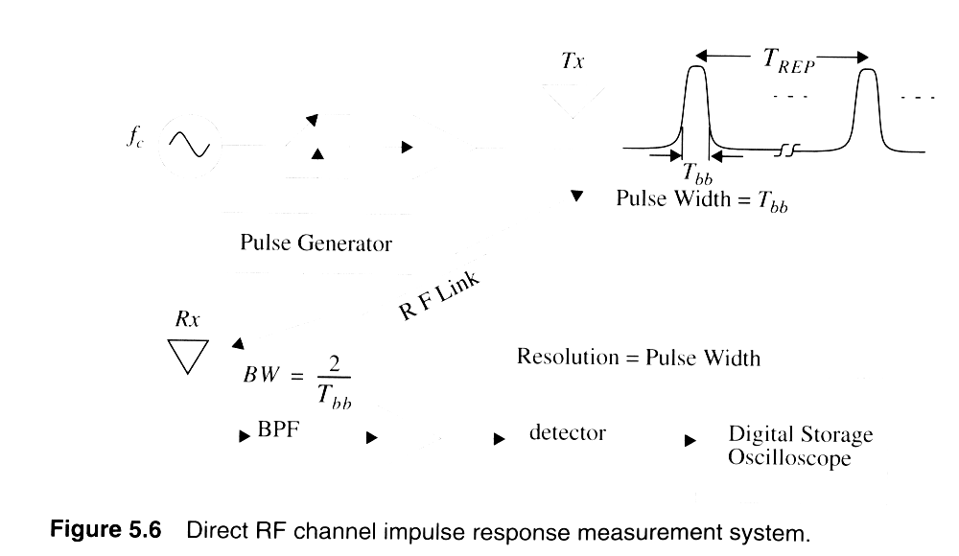
Channel Sounder: Pulse type

Slide 8
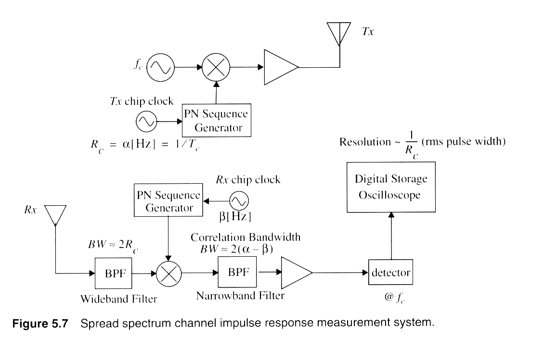
Channel Sounder: PN Type
Notes:
Fig. 2.4

Slide 9
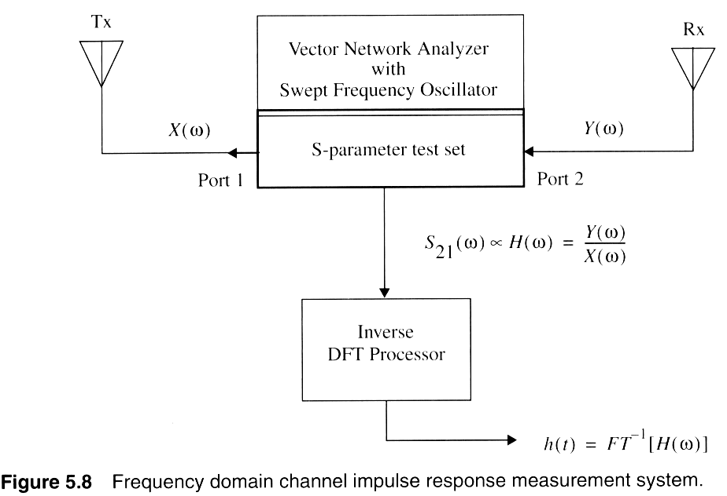
Channel Sounder: Swept Freq. type
Notes:
Fig. 2.5

Slide 10
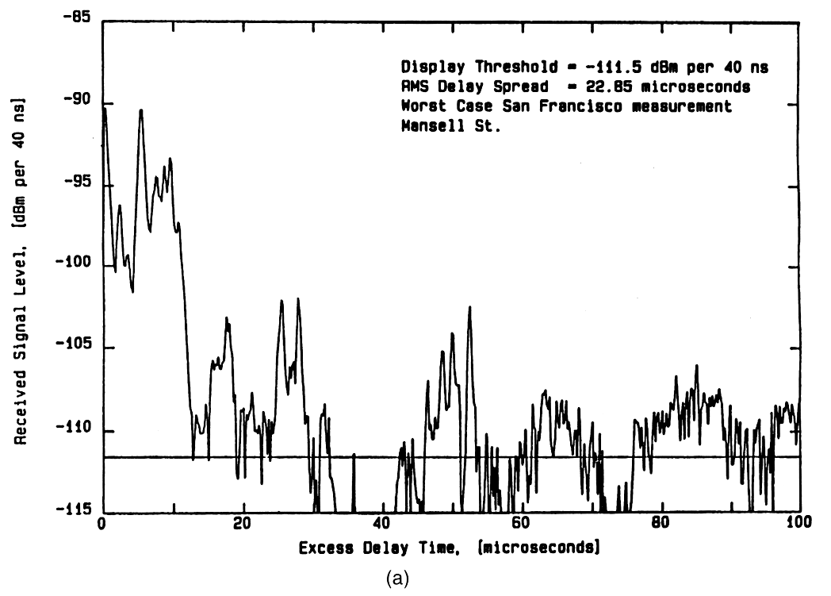
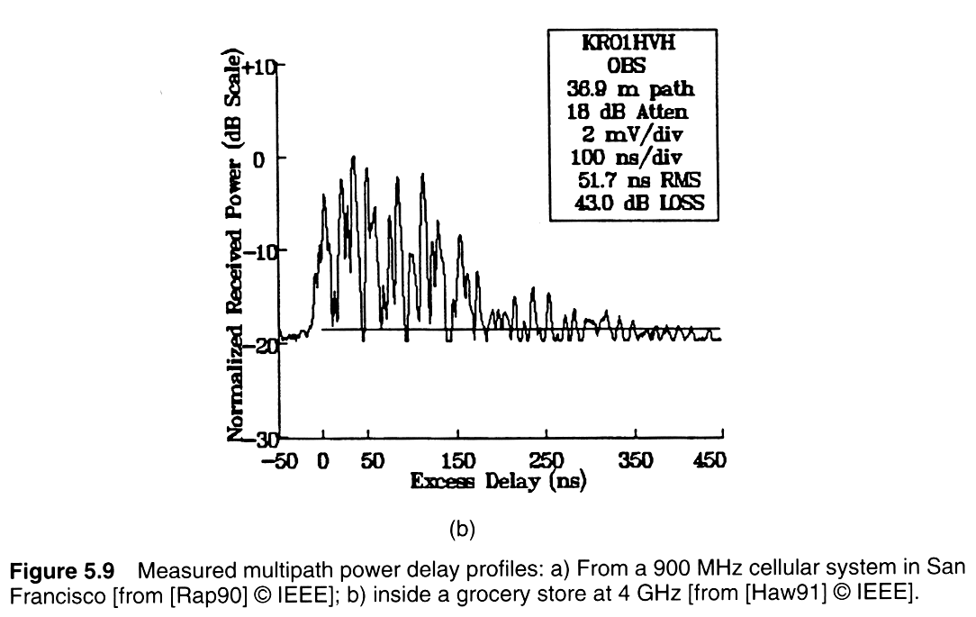
Measured power delay profiles
Notes:
Fig. 2.6

Slide 11
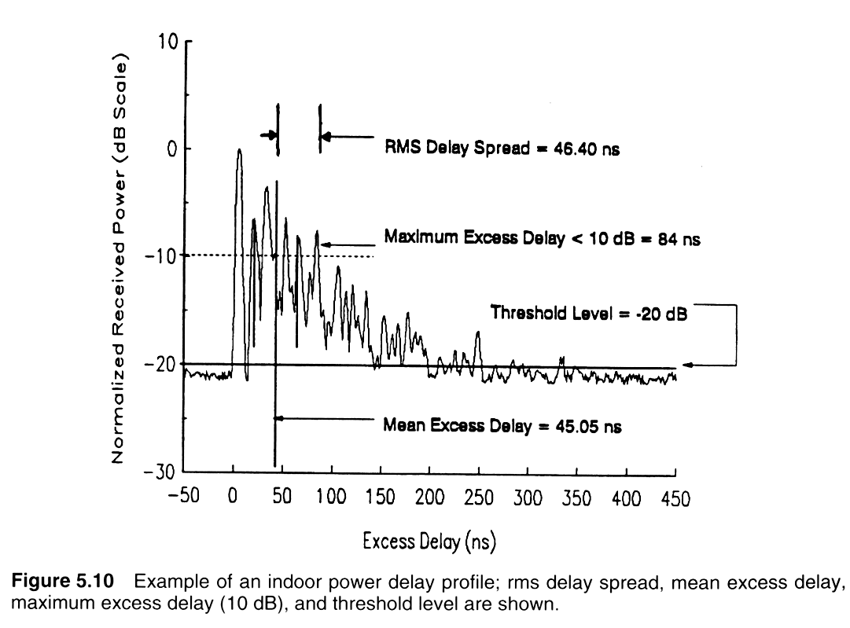
Indoor Power Delay Profile
Notes:
Fig. 2.7

Slide 12
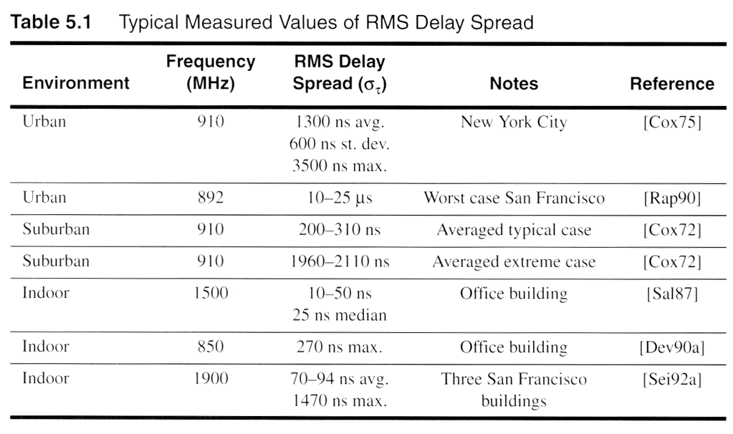
Typical RMS delay spreads
Notes:
Fig. 2.16

Slide 13
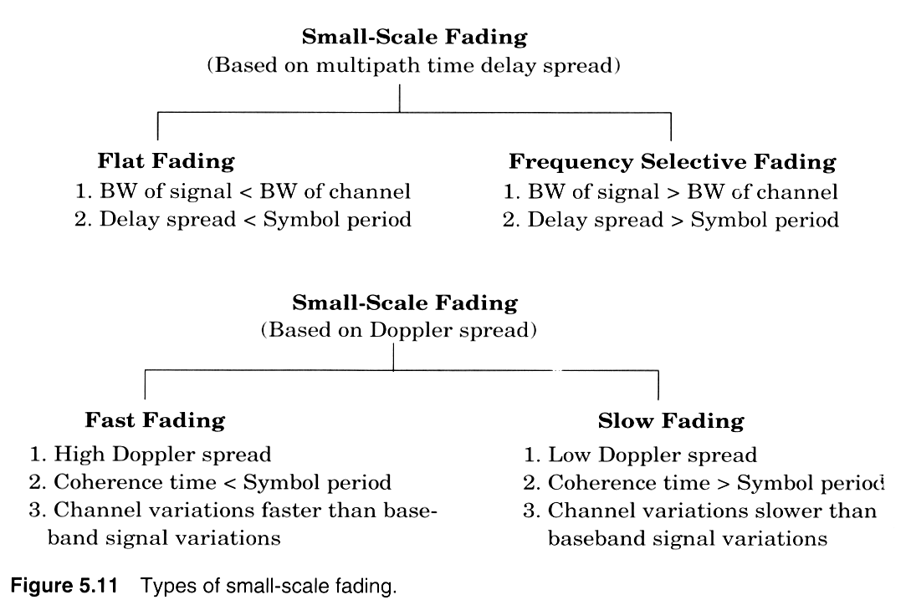
Two independent fading issues
Notes:
Fig. 2.8

Slide 14
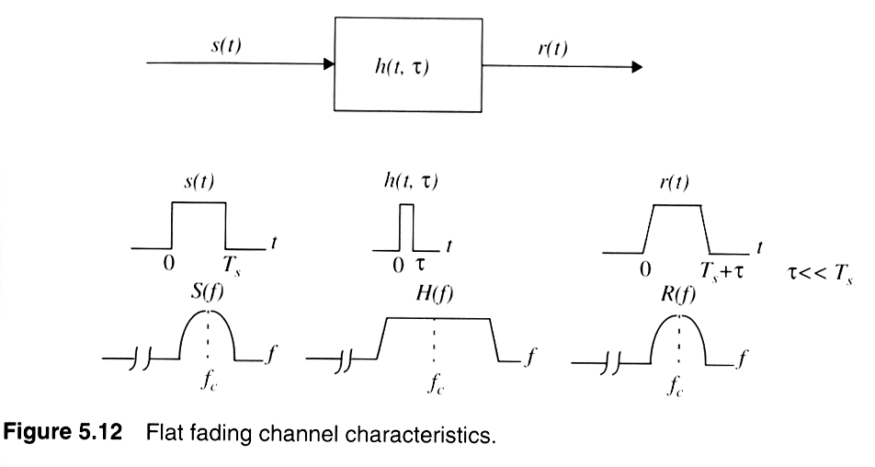
Flat-fading (non-freq. Selective)
Notes:
Fig. 2.9

Slide 15
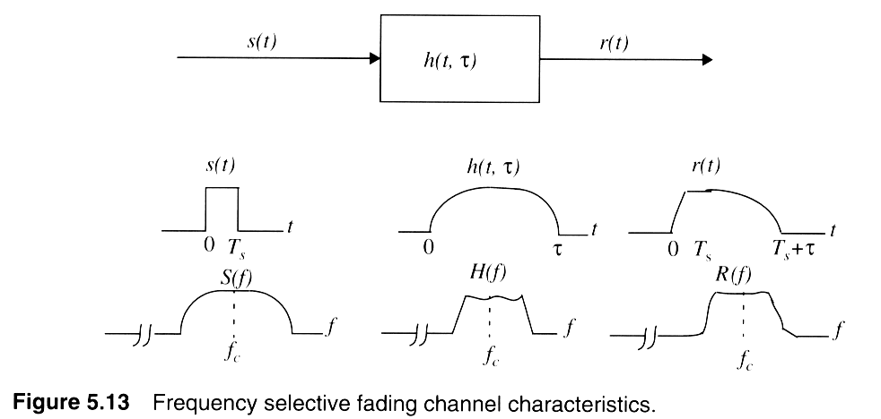
Frequency selective fading
Notes:
Fig. 2.10

Slide 16
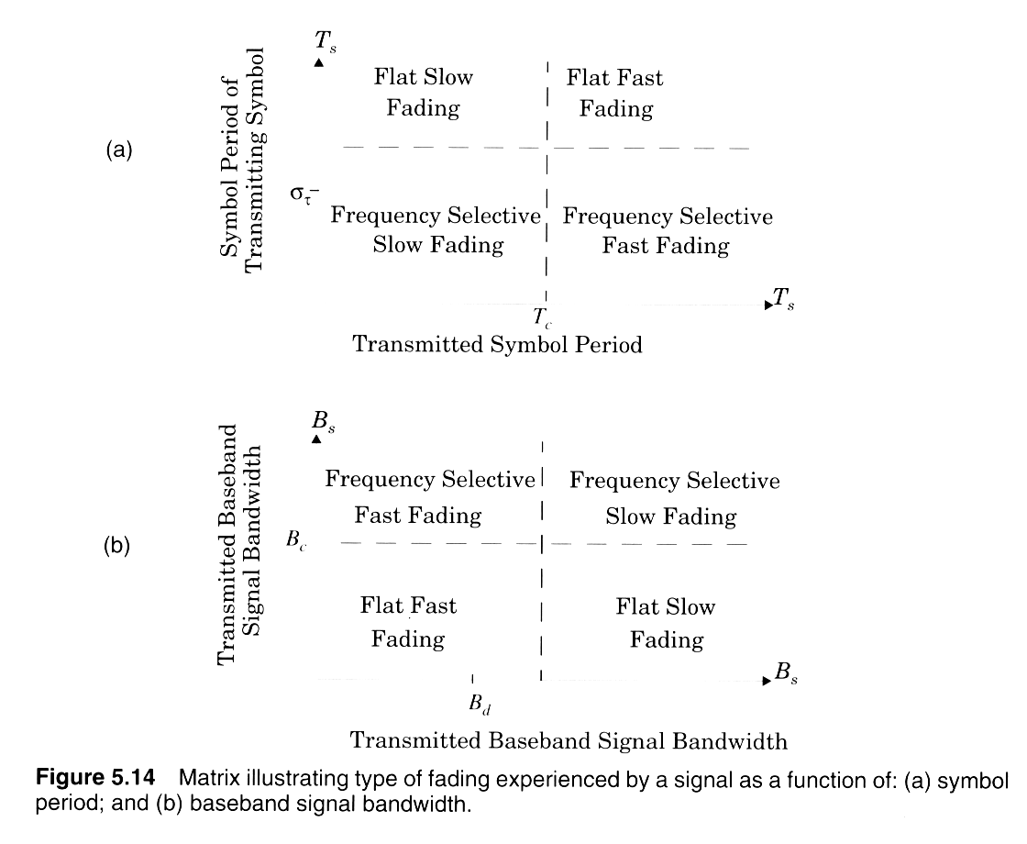
Two independent fading issues
Notes:
Fig. 2.11

Slide 17
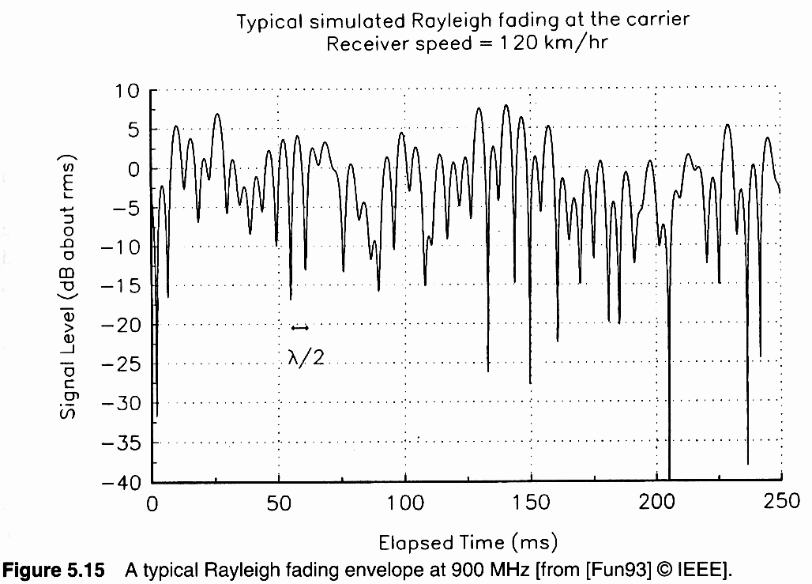
Rayleigh fading
Notes:
Fig. 2.12

Slide 18
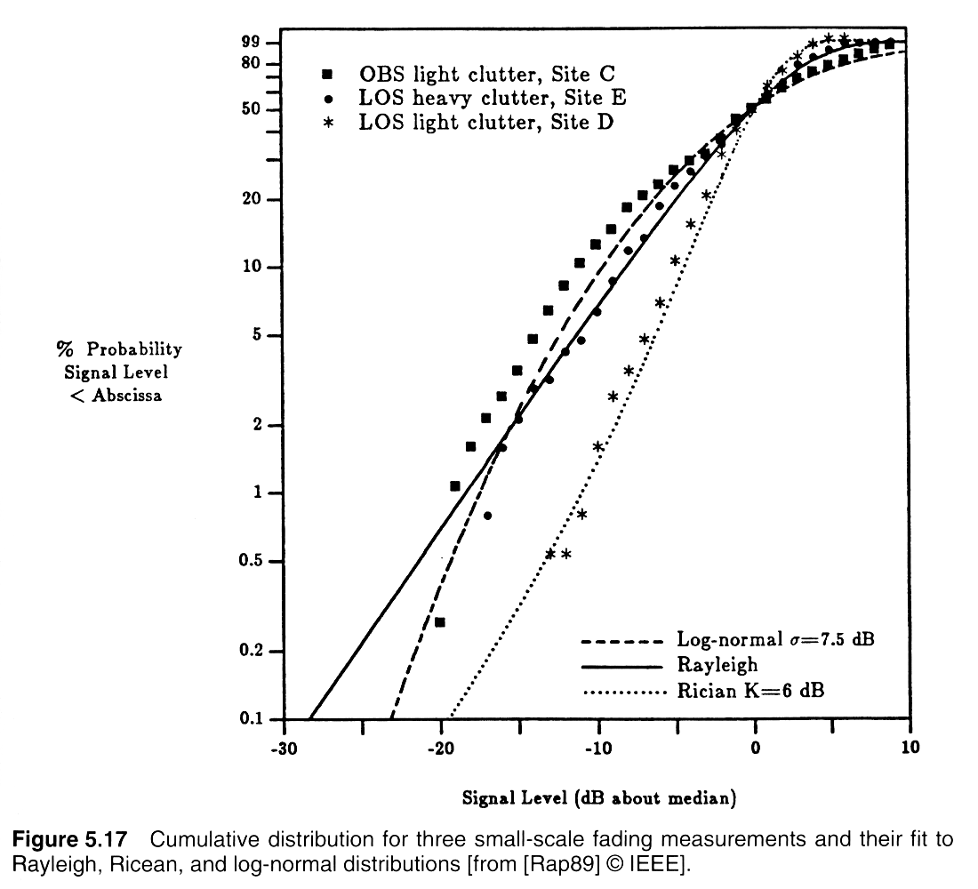
Small-scale envelope distributions
Notes:
Fig. 2.13

Slide 19
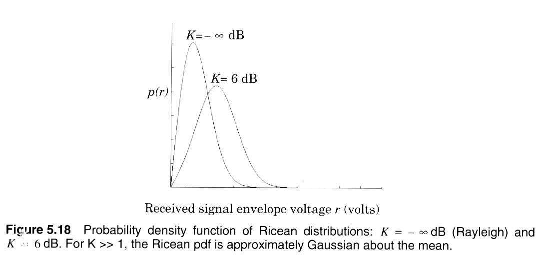
Ricean and Rayleigh fading distributions
Notes:
Fig. 2.14

Slide 20
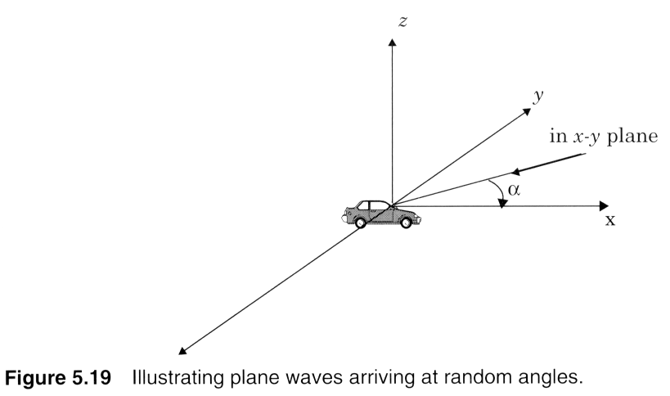
Small-scale fading mechanism
Notes:
Fig. 2.15

Slide 21
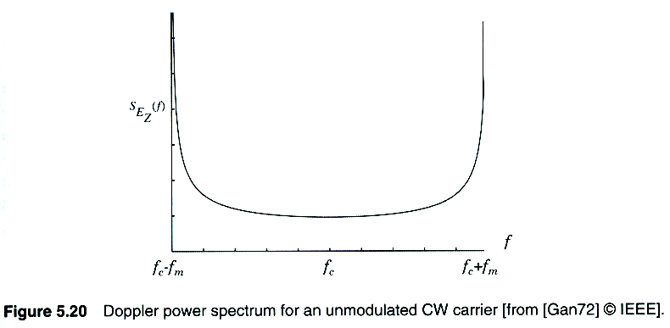
Doppler spectrum
Notes:
Fig. 2.16

Slide 22
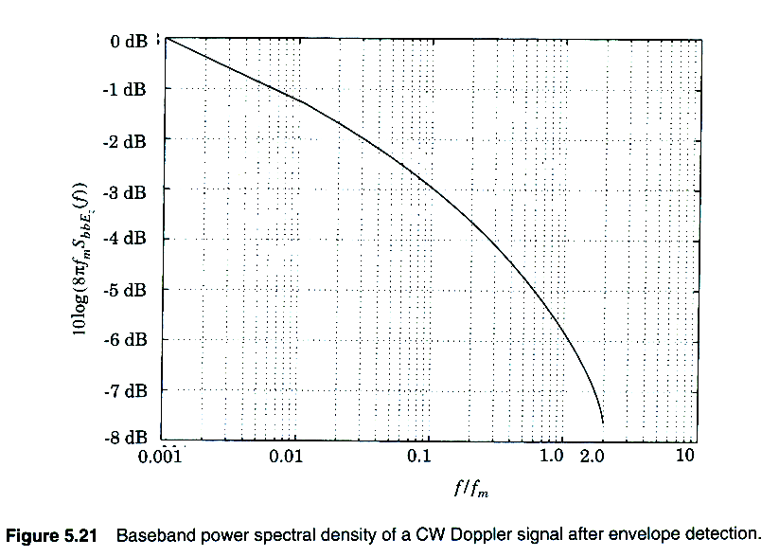
Spectrum of Envelope of doppler faded signal
Notes:
Fig. 2.16

Slide 23
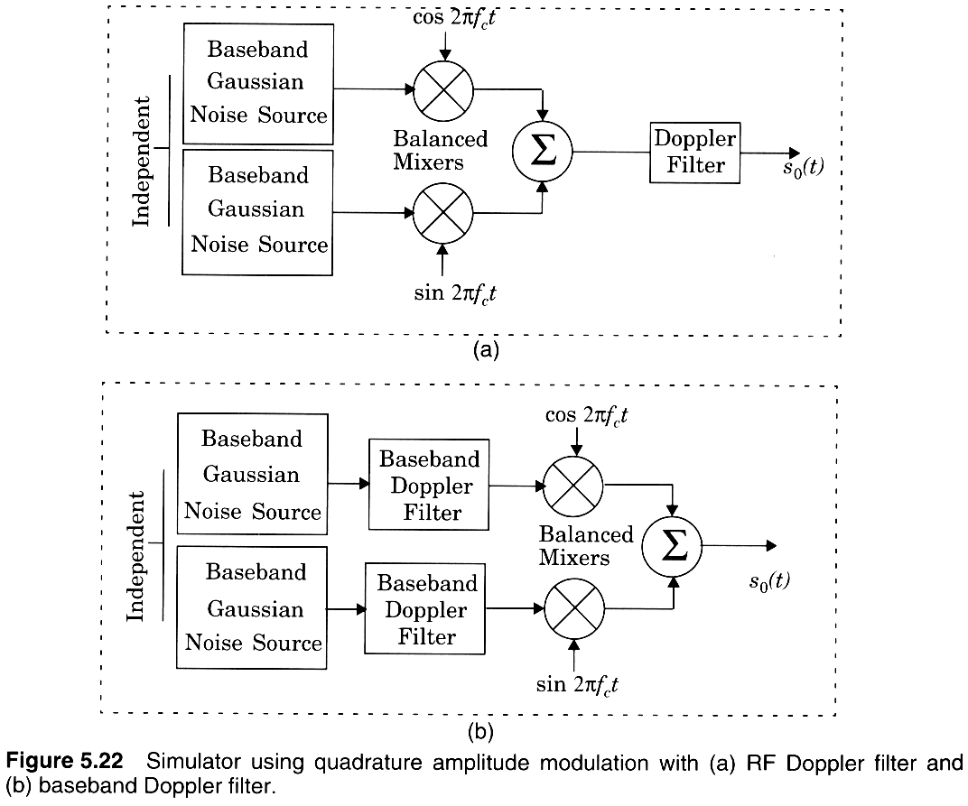
Simulating Doppler/Small-scale fading
Notes:
Fig. 2.16

Slide 24
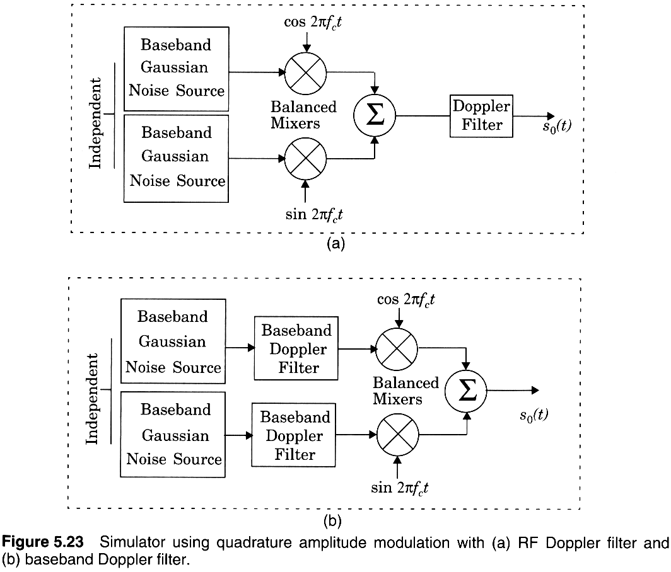
Simulating Doppler fading
Notes:
Fig. 2.16

Slide 25
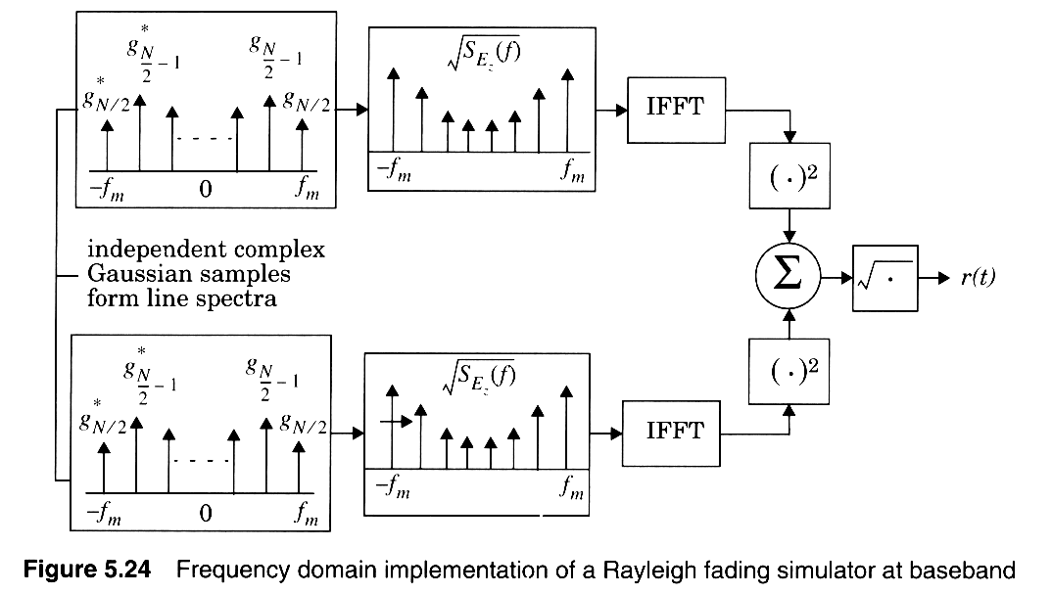
Simulating Doppler fading
Notes:
Fig. 2.16

Slide 26
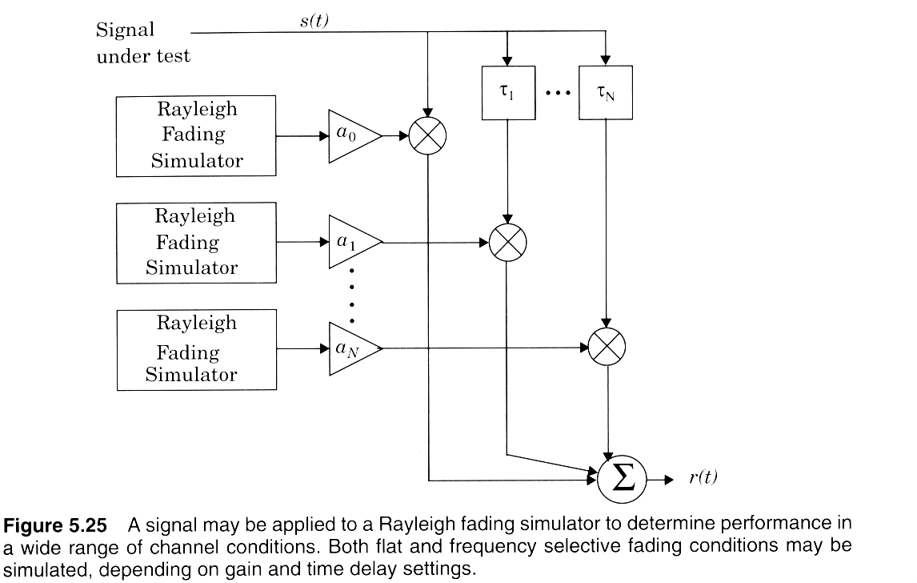
Simulating multipath with Doppler-induced Rayleigh fading
Notes:
Fig. 2.16

Slide 27
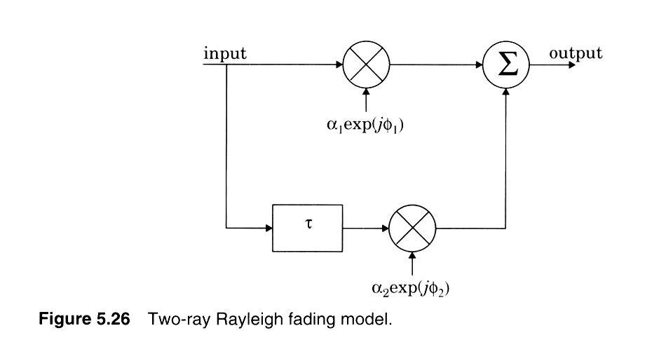
Simulating 2-ray multipath
Notes:
Fig. 2.16

Slide 28
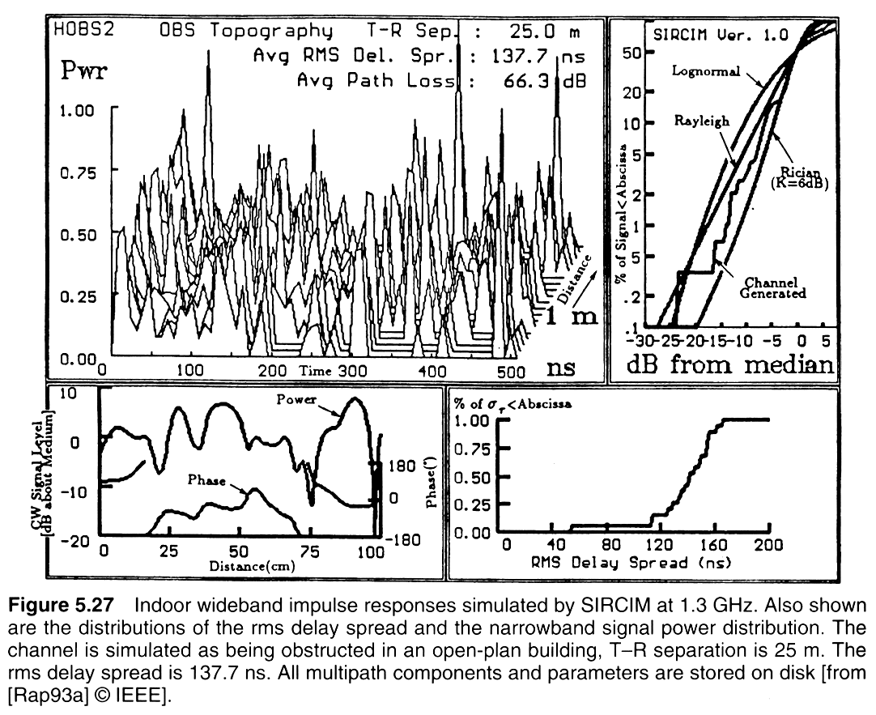
SIRCIM – Simulation of all indoor propagation Characteristics
Notes:
Fig. 2.16

Slide 29
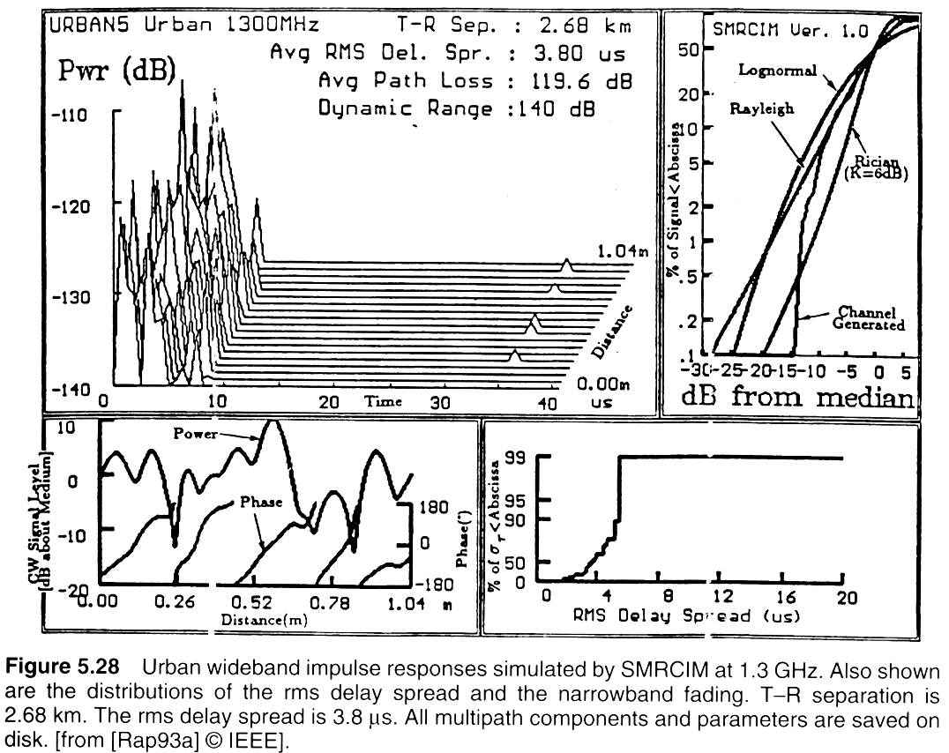
SMRCIM – Simulation of all outdoor propagation Characteristics
Notes:
Fig. 2.16

Slide 30
SIRCIM and SMRCIM
Available from Wireless Valley Communications, Inc.
Source code in C is available
www. Wirelessvalley.com

Slide 31
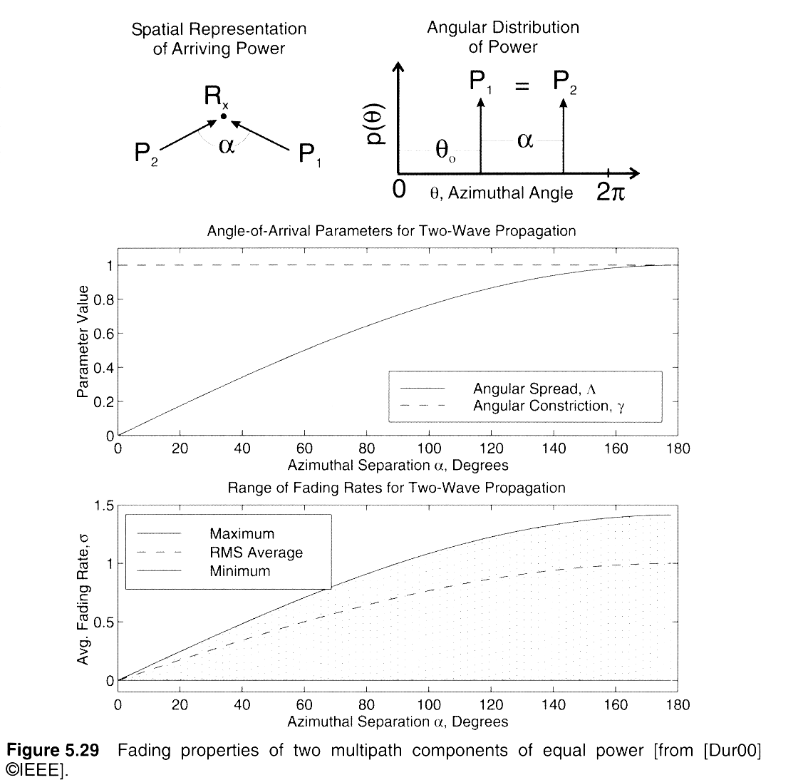
Angular Spread model
Notes:
Fig. 2.16

Slide 32
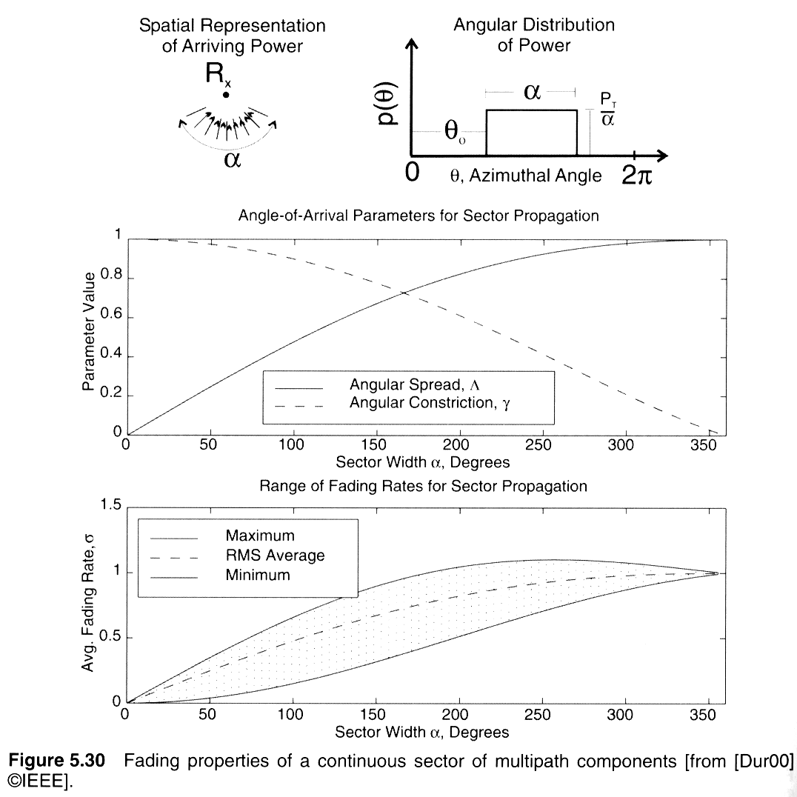
Spatial distribution of Multipath
Notes:
Fig. 2.16

Slide 33
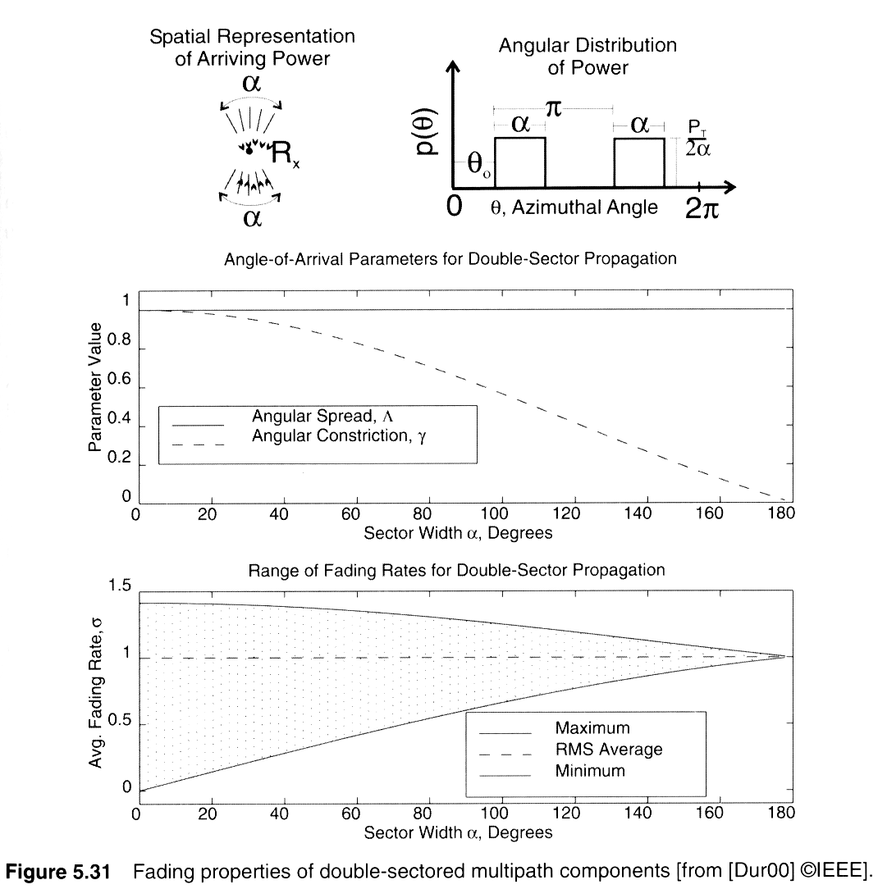
Angular Spread key to fading
Notes:
Fig. 2.16

Slide 34
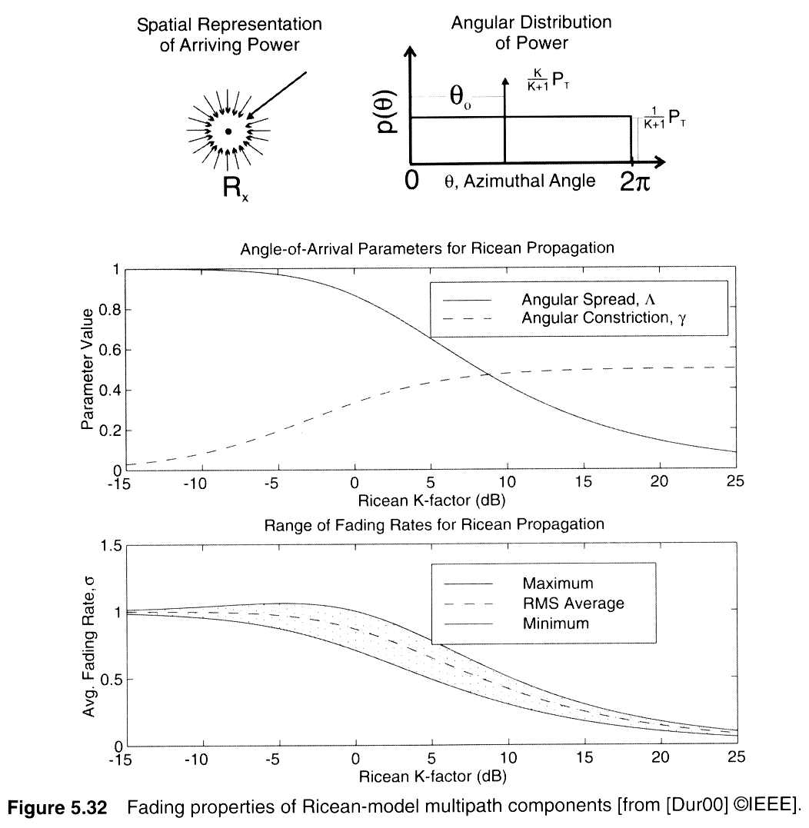
Spatial orientation of multipath impacts the depths of fading
Notes:
Fig. 2.16

Slide 35
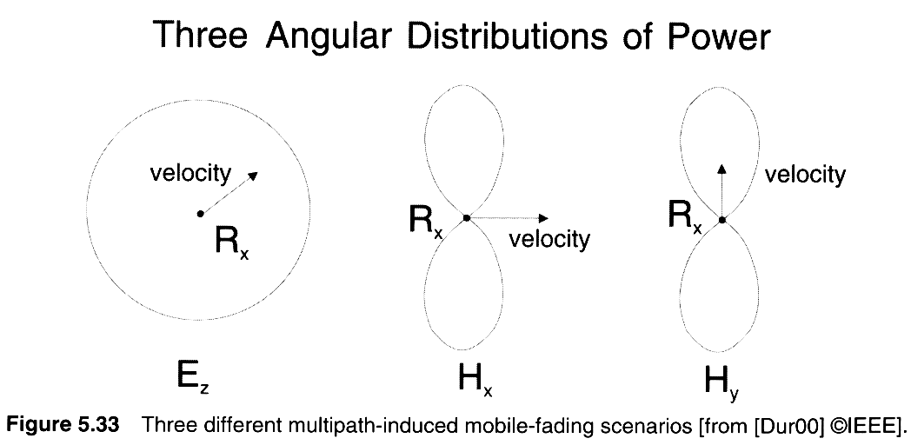
Angular Distribution of power
Notes:
Fig. 2.16

Slide 36
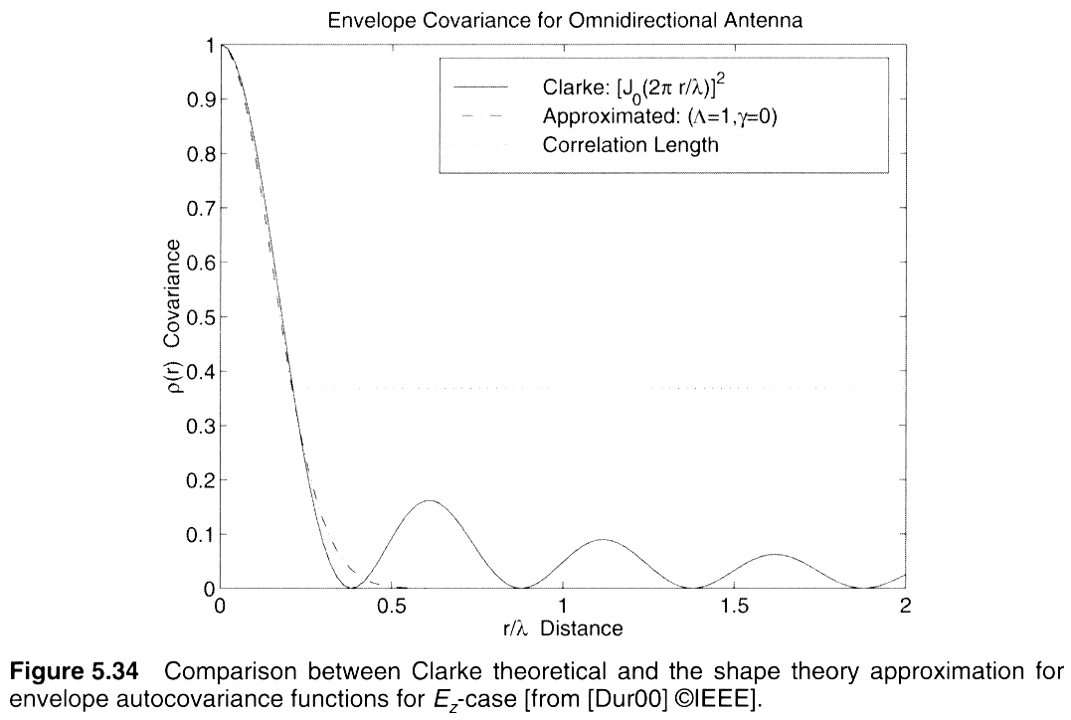
Angular Spread predicts correlation distances
Notes:
Fig. 2.16

Slide 37
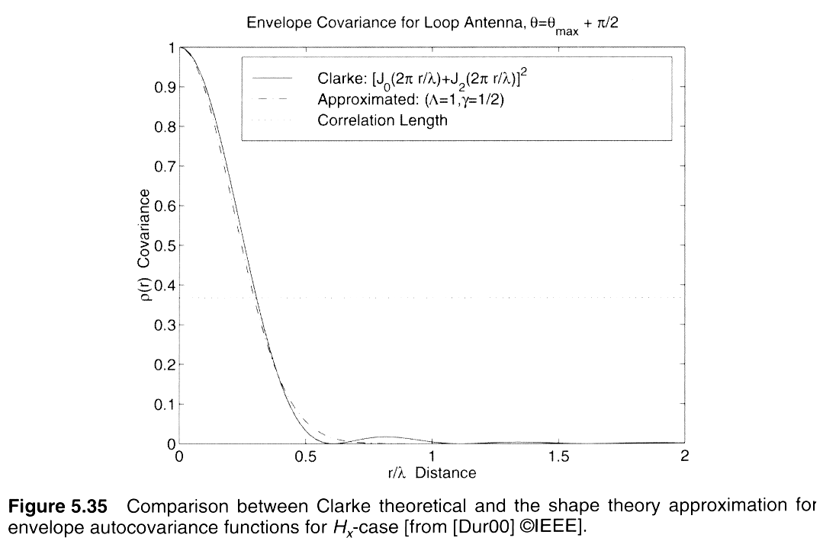
Angular Spread predicts correlation distances
Notes:
Fig. 2.16

